Slide 1
Exploring network security using Netsim
Miti Mazmudar
Notes:
Introduce myself. Welcome. Go through schedule and register on netsim. Has everyone registered?

Slide 2
Netsim Registration info.
Register for Netsim at:
https://netsim.erinn.io/
Save passwords in your browser; they cannot be recovered. (Progress will be lost if you forget your password.)

Slide 3
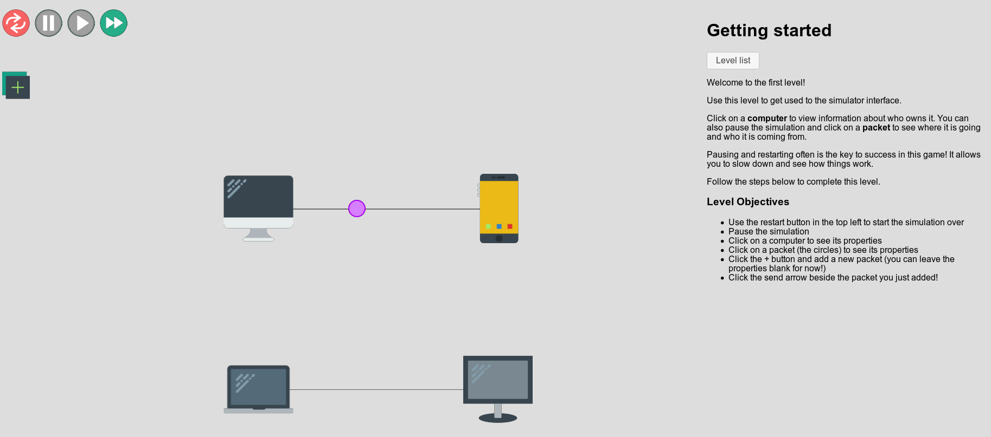
Netsim Interface
Notes:
So this is what the game looks like. Instructions are on the right hand side. You can pause, restart and fast-forward the animation with the buttons on the top left.
Casing may matter. Pay attention to what is capitalized. If all else fails and you think you are right, refresh.
The first game just familiarizes you with the interface.

Slide 4
Netsim game overview
An online game to teach computer networks and network security
Network simulator design: each game shows devices connected by links, sending packets. Craft (and time) packets to win game objectives!
Active and experiential learning by design: Success message on triggering a ‘correct’ packet.
Game levels grouped by theme.
Notes:
Netsim is an online game intended to teach basics of computer networks and introduce students to different types of network security attacks. So players can register and login to the game, and their progress is saved. Netsim is designed as a network simulator. So each game shows a simulation of devices connected by links, and these devices send packets to each other. Players craft packets with different fields to achieve the objectives of each level of the game. Players usually tweak fields until they craft a correct packet and in some games, send it at the correct time, and when they do, get a success message for that level. So by design, Netsim provides positive feedback on completing each level and supports experiential or active learning. Currently, the game consists of thirteen levels which are grouped into four themes.

Slide 5
Netsim history
Developed by CrySP alumni Cecylia Bocovich & Erinn Atwater.
Featured in workshops for high-school audiences: SPARCS, CS Girls Rock, WicsCON
Online + in-person workshops.
Notes:
Many CrySP grad students have facilitated Netsim workshops targeted at a high-school audience for Sandy Graham’s SPARCS, CS Girls Rock, WicsCON workshops.
A bit of personal history: I’m interested in encouraging and supporting high-school girls to take up CS and I’ve done a Certificate of University Teaching. In this workshop, you will ….

Slide 6
Outline
Security pre-requisites
Computer networks pre-requisites
Game play: Basics + Spoofing
Walkthrough: Stealing packets
Walkthrough: Man-in-the-middle attack
Integrating & extending Netsim
Activity: Designing your Lesson plan
Takeaways
Notes:
We’re going to first start with covering introductory concepts in security and networking that would be helpful for the game. You then get to go try out Netsim and win a few game levels. We’ll then come back in and I’ll walk through a couple of activities: stealing packets and man-in-the-middle attack. These are detailed walkthroughs and you can simply build off my slides for your classes.
I’ll then discuss how you can integrate Netsim into your in-person, online or flipped classroom and motivate you with some ideas on extending Netsim. You’ll get a chance to design your own lesson plan and then we’ll conclude with takeaways. I’ll hang around a bit later if you want to continue with the gameplay and ask questions.

Slide 7
Security pre-requisites
Notes:
With that motivation, We have a few security concepts that students should be introduced to, before starting the game.

Slide 8
Security concepts - attacker, threats
An adversary or an attacker
Threats: Ways through which an attacker can harm the system or users
Notes:
We begin with the notion of an adversary or an attacker who harms systems for some end goal: money, information, or to cause personal harm. We use Eve’s persona as the attacker in this game. The ways through which the attacker can harm the system or users, are known as threats.

Slide 9
Security concepts - threat types
Games explore different types of threats:
Fabrication (e.g. spoofing)
Interception (e.g. stealing packets, man-in-the-middle) Discussed today!
Interruption (e.g. DoS)
Helpful to use this classification to structure your lessons and to assess students after playing the game. Threat types are underlined in the instructor notes.
Notes:
Games address different types of threats — some games address a common threat.
First, an attacker can come up with fake data that is intended to deceive you. This is the fabrication threat. The spoofing activity is an example of a fabrication threat.
Second, an attacker can intercept or seize your data, when you meant to send the data to someone else or data that is intended to come to you. We have two activities as examples of the interception threat: the stealing packets activity and the man-in-the-middle activity. We’ll discuss these activities today.
Third, an attacker may just stop a service or turn off a machine that you are trying to access. The DoS activity is an example of the interruption threat.
This classification is helpful to structure your lessons, so for example, if you don’t have a lot of time to go through all games, you might choose one game for each type of threat. Note that threat types are underlined in the instructor notes. Students don’t need to know these terms beforehand. You can have them classify games into different types of threats later on, as an assessment.

Slide 10
Security concepts - CIA
Goals of a security engineer:
Hiding a message from others: Confidentiality (Encryption)
Keeping your message accurate: Integrity
Keeping systems accessible at all times: Availability
The game introduces availability through an activity (DoS). Define confidentiality and integrity in class.
Notes:
Students should be able to define three main goals that a security engineer would have:
First, when you send a message from to your friend, it should only be known to the two of you, and should be hidden from others --- so your message should be kept confidential.
We also want to keep your message accurate and ensure it is not modified by others --- ensure its integrity.
Finally, we want to have access to the system at all times (in light of the interruption threat) --- this is availability.
The game does a good job of introducing availability through an activity. You should introduce and define confidentiality and integrity in class. Of course, you can go through all of them in class.

Slide 11
Security concepts - encryption
Beforehand:
Define encryption in terms of confidentiality and integrity.
Describe encryption and decryption operators in terms of a plaintext, a ciphertext and a secret key.
Example: Walk through Caeser cipher activity
These concepts are needed for the man-in-the-middle activity
Notes:
Beforehand, students should be able to describe encryption as a tool to provide confidentiality and integrity. They should be able to describe encryption and decryption operators in terms of a plaintext, a ciphertext and a secret key. I will walk through an example of a Caeser cipher to achieve these LOs. Students need to know these concepts for the man-in-the-middle activity.

Slide 12
Instructor notes / players guide
For each game, the notes include:
Learning outcomes
Types of threats explored (underlined)
Background on the attack
Success triggers: Packet fields and any timing information

Slide 13
Networks prerequistes

Slide 14
Networks pre-requisites: packets & protocols
Define packets as consisting of a message and a header that describes the packet.
Define a protocol as a common standard followed by computers to achieve a goal.
Give an example of a protocol (Internet Protocol) and its goal (addressing devices and transferring packets from a source to a destination).
List packet header fields used to address a packet: source and destination IP addresses.
Source IP address abbreviated as srcIP, destination IP address abbreviated as dstIP
Recognize that packets can contain headers for different protocols.
Notes:
In the packets activity, the game abbreviates source IP addresses as srcIP and destination IP addresses as dstIP.
Protocol examples: The game introduces ICMP through the ping activity.
I’ve introduced packets by analogy to packages that they order from Amazon. (Letters are an outdated example by now.) I’ve used the analogy of packets as having layers of headers like an onion, with the message nestled inside. Though students don’t need to understand encapsulation per se, they simply need to know that packets can have different headers for different protocols, and so for different goals.

Slide 15
Time to play!
All Basics game level activities: Getting started, packet fields, ping, routing, modems.
Spoofs game level: Do IP Spoofing. Indicate when you’re done.
We’ll go through Stealing Packets & Man-in-the-middle together.
Notes:
Do the first set of exercises in Basics. We’re going to go through the first set of activities in Basics and then go through the Stealing packets activity.
We’ll then do another set of activities and work through the last security activity.

Slide 16
Stealing packets game

Slide 17
Stealing packets — learning outcomes
In the previous activity (IP spoofing), you used IP spoofing to impersonate another computer. After this activity, you will be able to:
Describe how switch tables are read from and written to.
Use IP spoofing to steal packets that are intended to be sent to others.
Recognize stealing packets as an interception threat.
Demonstrate the importance of timing in attacking systems.
Notes:
So let’s start with the previous question — we spoofed IP source addresses, in order to impersonate another computer.
After this activity, you will be able to …
This activity demonstrates how switch tables work.You’ll use IP spoofing to steal packets that are intended to be sent to someone else. This is an example of an interception threat. This activity also demonstrates the role of timing in attacking systems.

Slide 18
Stealing packets - attack logic
Use Alice to steal a packet from Google to Charlie:
Google’s response packet should go to Alice instead of Charlie.
We know how to spoof packets, so Alice can send a request to Google, pretending to be Charlie.
What packet should Alice create? (srcIP, dstIP, proto)
Notes:
So here, a series of packets are being sent. The last one is a packet from Charlie to Google. Google responds back with a packet to Charlie. We want to *use* Alice to steal a packet from Google to Charlie. This means that Google’s response packet should go to Alice instead of Charlie.
NOW we know how to spoof packets, so Alice can send a request pretending to be Charlie. What packet should Alice create? Write down the source IP, the destination IP and the protocol field.

Slide 19
Stealing packets - attack logic
Use Alice to steal a packet from Google to Charlie:
Google’s response packet should go to Alice instead of Charlie.
We know how to spoof packets, so Alice can send a request to Google, pretending to be Charlie.
What packet should Alice create? (srcIP, dstIP, proto)
srcIP: Charlie, dstIP: Google, proto: ICMP
When should Alice send this packet?
We need to understand the switch behaviour.
Notes:
So now the question is — when should Alice send this packet? We need to understand the switch behaviour. We’re gonna look closely at the simulation.

Slide 20
Stealing packets - switch table
The switch has a table, which associates a link (black line between devices) with an IP address.
{link 1} → {Miti’s IP}
With each packet that the switch receives on a link:
How does the switch use the switch table?
How does the switch update the switch table?
Notes:
So here’s an example of what a switch table looks like. It maps a link to an IP address and for this example as well as the game, we just use people’s names in place of their IP address. And we number links here.
With each packet that the switch receives on the link, we want to answer two important questions about the switch’s behaviour. How does the switch use the switch map? And how does it update the switch map?

Slide 21
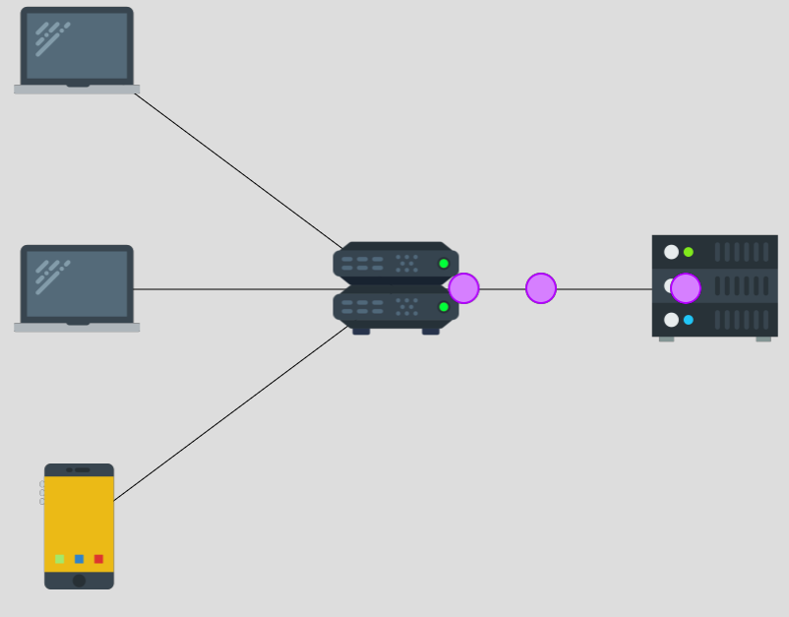
At switch: Google to Bob
Packet info
srcip | Google
dstip | Bob
Switch table
IP | Link
Black lines connecting devices are links.
Notes:
Now the switch gets the first packet from the right link, which has a source IP of Google and a dest IP of Bob, so this packet should go to Bob.
Whenever the switch sees a packet coming on a link, it first looks at its switch table. The switch wants to find out what link it should send the packet to, or rather, what link Bob is on.
The switch map is empty, so the switch does not know which link Bob is on.

Slide 22
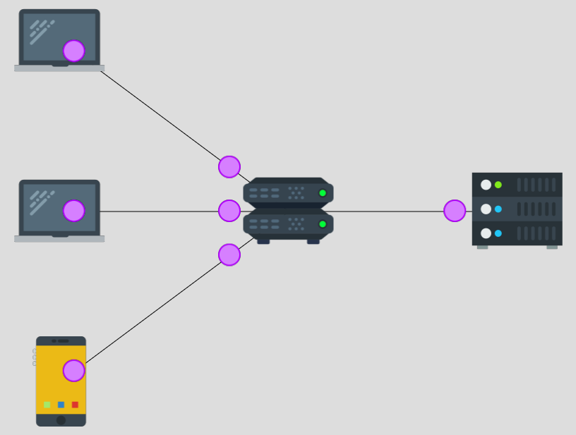
Switch processes: Google to Bob
Packet info
srcip | Google
dstip | Bob
Switch table
IP | Link
Google | Right
Notes:
When the switch map is empty, the switch simply sends the packet on all other links connected to it. So you can see in the next step, the switch sends the packet on all three links on the left-hand side, so Bob gets the packet, and additionally, Alice and Charlie also get the packet.
Importantly, once the switch gets this first packet, it learns something. It learns that packets on the right link come from the source IP of Google, so it learns that “Google is on the right link”. So, it updates its switch table by adding this entry.
In other words, whenever the switch receives a packet on a link, it adds an entry, or updates an existing entry.
The new entry associates the source IP of the packet, to the link that the switch received the packet on.

Slide 23
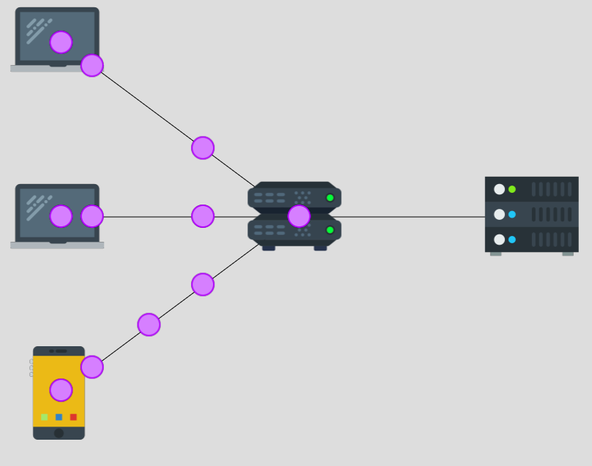
At switch: Charlie to Google
Packet info
srcip | Charlie
dstip | Google
proto | ICMP
Switch table
IP | Link
Google | Right
Notes:
Now the switch gets those two packets from the bottom link with the destination IP of Google. They are in the red boxes here. So the switch looks at the switch table again, to figure out where to send these packets to. The switch wants to know which link corresponds to Google.
This time, the switch map is not empty, as we just discussed. In fact, the switch map contains one entry, which maps Google to the right link.

Slide 24
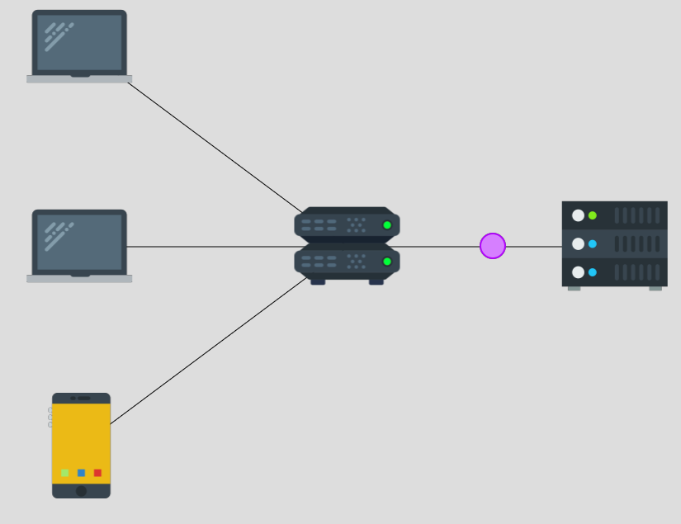
Switch processes: Charlie to Google
Packet info
srcip | Charlie
dstip | Google
proto | ICMP
Switch table
IP | Link
Google | Right
Charlie | Bottom
Notes:
So the switch sends the packets from the bottom link, only to the right link.
The switch also updates its switch table, after it has processed the first packet from the bottom link.
The switch got a packet from the bottom link with the source IP of Charlie, so it adds an entry mapping the bottom link to Charlie’s IP. (Based on source addresses)

Slide 25
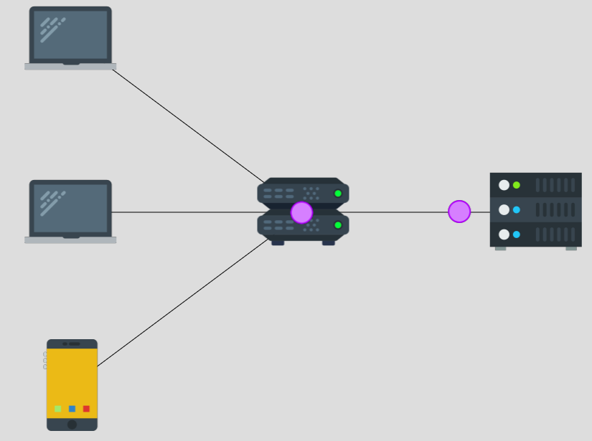
At switch: Google to Charlie
Packet info
srcip | Google
dstip | Charlie
proto | ICMP
Switch table
IP | Link
Google | Right
Charlie | Bottom
Notes:
So now when the switch gets the packets *from* Google on the right link, it sends them back on the bottom link, precisely because of this second entry in its switch map.
The switch considers adding an entry to its switch table, with the source IP of the packet it just received. But, the switch does not need to add an entry to its switch table. Can someone tell me why?
The switch would’ve added an entry associating Charlie to the bottom link. But the second entry in the table is exactly that — so the switch does not need to add another entry or update this entry.

Slide 26
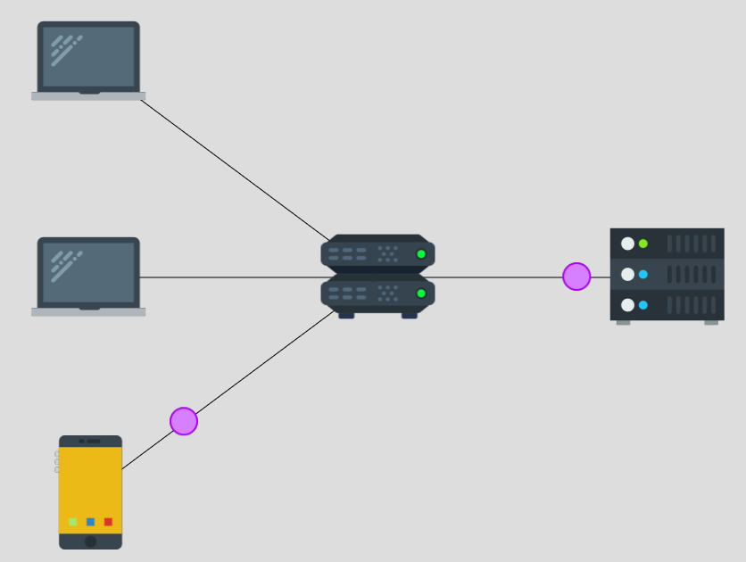
Switch processes: Google to Charlie
Packet info
srcip | Google
dstip | Charlie
proto | ICMP
Switch table
IP | Link
Google | Right
Charlie | Bottom
Notes:
And the switch correctly send these packets from Google to Charlie on the right link.

Slide 27
At switch: Charlie (sent by Alice) to Google
Packet info (as Alice)
srcip | Charlie
dstip | Google
proto | ICMP
Switch table
IP | Link
Google | Right
Charlie | Bottom Top
Alice sends a packet on the top link, pretending to be Charlie.
The switch updates its switch table.
But, depending on the timing, the switch table could change again. Google’s ICMP response might not go to the top link.
Notes:
So as Alice, our goal is to steal a packet from Google to Charlie. So Alice should receive a packet with a source IP of Google and a dest IP of Charlie, under the ICMP protocol. So to do that, Google would have received a packet, from Charlie. From the previous activity, we know Alice can spoof her own source IP. So we send this spoofed packet as Alice.
When the switch receives this packet, it will update the existing entry from “Charlie: Top” to “Charlie: Bottom”.
However, depending on the timing, the switch table could change again.
The switch table could look different by the time the switch gets a packet from Google. So the switch might not direct Google’s ICMP response back to the top link.

Slide 28
Timing options
Alice can send the spoofed packet either:
Before the switch processes any packets from real Charlie
After the switch processes the 1st packet from real Charlie but before it processes the 2nd packet.
After the switch processes both packets from real Charlie.
After the switch processes both packets from Google to real Charlie.
Notes:
So we can send our spoofed packet at different times and that would have different impacts on the switch table.
Let’s start with the first case: sending the spoofed packet before the switch processes any packets from the real Charlie.

Slide 29
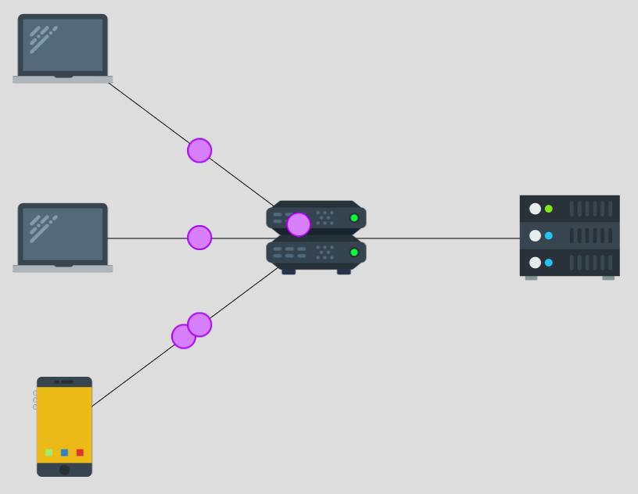
Before any packets from (real) Charlie
Packet info (sent by Alice)
srcip | Charlie
dstip | Google
proto | ICMP
Switch table
IP | Link
Google | Right
Charlie | Bottom Top ????
Send our packet (in red box) before any packets from the real Charlie (in white box) arrive at the switch
Notes:
So we have a diagram for this case, with our spoofed packet in the red box and real Charlie’s first packet in the white box.
Once the switch processes our packet, it would update the switch table’s row associating Charlie to the bottom link and instead associates Charlie with the top link.
Now the switch would process the packet in the white box, which comes from real Charlie.
Can someone tell me what happens to the switch table, once the switch processes the packets from the real Charlie?

Slide 30
Before any packets from (real) Charlie
Packet info (sent by Alice)
srcip | Charlie
dstip | Google
proto | ICMP
Switch table
IP | Link
Google | Right
Charlie | Bottom Top Bottom
Send our packet (in red box) before any packets from the real Charlie (in white box) arrive at the switch
Notes:
Well, the first packet from Charlie updates the switch table, and the switch goes back to associating the bottom link with Charlie. So Alice’s attack is not successful.

Slide 31
After real Charlie’s first packet but before the 2nd packet
Packet info (as Alice)
srcip | Charlie
dstip | Google
proto | ICMP
Switch table
IP | Link
Google | Right
Charlie | Bottom Top Bottom
Send our packet (in red box) after the switch processes the 1st packet from the real Charlie (in white box), but before the 2nd packet arrives at the switch.
Notes:
In the second case, we send the packet a bit later. Here, you can see our spoofed packet packet in a red box, is reaching the switch after the first packet (in a white box on the right) from the real Charlie has reached Google.
But before the real Charlie sends the second packet from their yellow phone, in the bottom.
What happens to the switch table in this case?
Again, due to the second packet, the switch associates Charlie with the bottom link.

Slide 32
Timing options
Alice can send the spoofed packet either:
Before the switch processes any packets from real Charlie: Too early
After the switch processes the 1st packet from real Charlie but before it processes the 2nd packet: Too early
After the switch processes both packets from real Charlie.
After the switch processes both packets from Google to real Charlie.
Notes:
In both first and second cases, we send the packet early, and the packets from real Charlie reset the switch table reset back to what it was initially. So we can send our spoofed packet later.

Slide 33
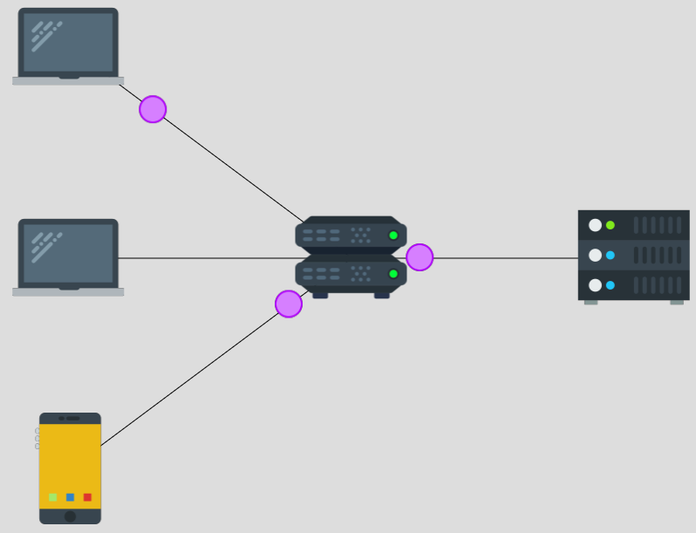
After both packets from real Charlie
Packet info (as Alice)
srcip | Charlie
dstip | Google
proto | ICMP
Switch table
IP | Link
Google | Right
Charlie | Bottom Top
Send our packet (in red box) after the switch processes the 2nd packet from the real Charlie (in white box). Also after any packets from Google (in blue box).
Notes:
In this diagram, we send the spoofed packet after both packets from real Charlie (to Google) have been processed at the switch. So by this time, the switch has also processed the first packet back from Google. When the switch gets the second packet from Google, it now sends this packet on the top link. Then Google responds to Alice’s spoofed packet, and the switch also directs this response on the top link.

Slide 34
Timing options
Alice can send the spoofed packet either:
Before the switch processes any packets from real Charlie: Too early
After the switch processes the 1st packet from real Charlie but before it processes the 2nd packet: Too early
After the switch processes both packets from real Charlie: Perfect timing
After the switch processes both packets from Google to real Charlie: Perfect timing
Notes:
We can send our spoofed packet even later — after the switch has processed both responses from Google. Again, there will be no changes to the switch table after the switch processes Alice’s spoofed packet.
You should be able to win the game if you time your packet under both third and fourth cases. The only difference between the third and fourth cases is the number of packets that Alice manages to steal. In the fourth case, Alice only gets Google’s response to its own spoofed packet. In the third case, Alice *also* steals the packet from Google to the real Charlie, which was in response to real Charlie’s 2nd packet.

Slide 35
Encryption & Man-in-the-middle activity

Slide 36
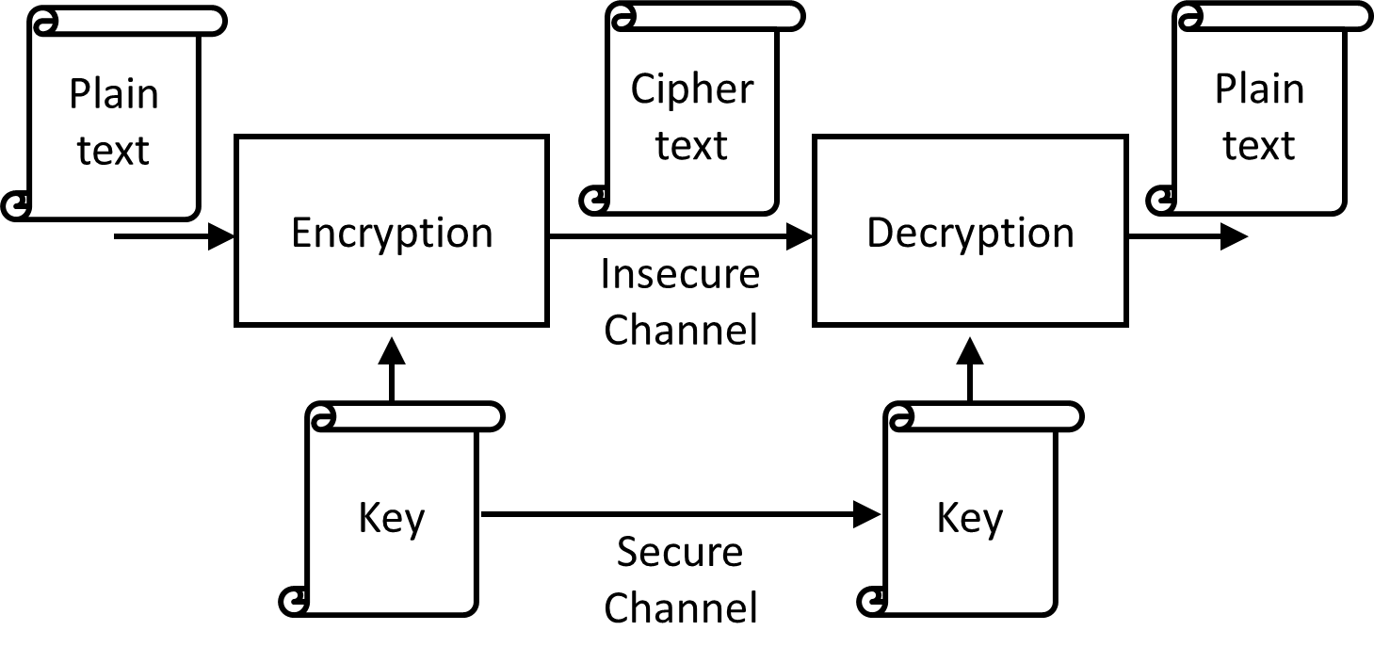
Ciphers
Notes:
Earlier we discussed that as a security engineer, we strive to have confidentiality. Going to our package delivery example, I’m ordering a package on Amazon. I use an ethernet cable connection from my home, and Sajin is my Internet Service Provider, like Rogers or Bell. I don’t trust Sajin and I don’t want Sajin to be able to read my order. So I want to communicate confidentially with Amazon.
In fact, I don’t even want Sajin to be able to change my order, and that is known as integrity.
So to communicate with confidentiality on the internet, we use ciphers. Amazon and I in this case, know of a secret key that no one, not even Sajin knows about. At its core, a cipher consists of two operations: encryption, and decryption, and these two operations are inverses of each other, just as addition and subtraction are inverses of each other. Whenever I want to send a message, or a plaintext, I garble it into a ciphertext, using the encryption operator. The garbled output of encryption is known as ciphertext.
Now I can give the ciphertext to Sajin and let Sajin send the message to Amazon. As I said earlier, decryption is the inverse of encryption. So Amazon takes the ciphertext, and the secret key, and decrypts the ciphertext to get the plaintext message which was my order for a package.
The cool thing about ciphers is that as long as Sajin doesn’t know the secret key, Sajin won’t be able to do the thing that Amazon does — Sajin won’t be able to decrypt the ciphertext.

Slide 37
Caesar cipher example: encryption
Encryption: Each letter in the plaintext alphabet is replaced by the k^{th} letter after it, to form the ciphertext. Example with k = 5:
Plaintext: “NETSIM IS GREAT”, Key: k = 5
Ciphertext: ??????
Plain | A | B | C | D | E | F | G | H | I | J | K | L | M | N | O | P | Q | R | S
Cipher | F | G | H | I | J | K | L | M | N | O | P | Q | R | S | T | U | V | W | X
Plain | T | U | V | W | X | Y | Z
Cipher | Y | Z | A | B | C | D | E
Notes:
So we start with an example of a millenia old cipher: the Caesar cipher. We work with alphabet letters in our example. I’ve defined the encryption operation in the Caesar cipher. Encryption replaces each letter in the plaintext alphabet by the k^{th} letter after it, to form the ciphertext. Here k is the key. The two tables on the slide compute an output ciphertext letter for a given input plaintext letter. I want to encrypt the plaintext: Netsim is great with the key k=5. I want you to compute the first word of the ciphertext.

Slide 38
Caesar cipher example: encryption
Encryption: Each letter in the plaintext alphabet is replaced by the k^{th} letter after it, to form the ciphertext. Example with k = 5:
Plaintext: “NETSIM IS GREAT”, Key: k = 5
Ciphertext: “SJYXNR NX LWJFY”
Plain | A | B | C | D | E | F | G | H | I | J | K | L | M | N | O | P | Q | R | S
Cipher | F | G | H | I | J | K | L | M | N | O | P | Q | R | S | T | U | V | W | X
Plain | T | U | V | W | X | Y | Z
Cipher | Y | Z | A | B | C | D | E
Notes:
So the correct ciphertext is shown on this slide.

Slide 39
Caesar cipher example: decryption
Encryption: Each letter in the plaintext alphabet is replaced by the k^{th} letter after it, to form the ciphertext.
Decryption should invert the encryption operation. It should take as input the ciphertext and the key, and output the plaintext.
Notes:
Now we want the decryption operation to invert or undo the effects of the encryption operation. It should take as input the ciphertext and the key, and output the plaintext. Can someone tell me what the decryption operation can be defined as?

Slide 40
Caesar cipher example: decryption
Each letter in the ciphertext alphabet is replaced by the k^{th} letter before it, to form the plaintext. Example with k = 5:
Check that ciphertext: “XJHZWNYD NX LWJFY” with key k=5 decrypts to plaintext: “SECURITY IS GREAT”
Cipher | F | G | H | I | J | K | L | M | N | O | P | Q | R | S | T | U | V | W | X
Plain | A | B | C | D | E | F | G | H | I | J | K | L | M | N | O | P | Q | R | S
Cipher | Y | Z | A | B | C | D | E
Plain | T | U | V | W | X | Y | Z
Notes:
So we can define the decryption operation to as replacing each ciphertext letter with the kth letter before it. I’ve just moved the ciphertext and plaintext rows in our table, to help us easily calculate the plaintext for our example with k=5. In fact, you can check that the ciphertext decrypts to “netsim is great”.

Slide 41
Caesar cipher
sjyxnr nx lwjfy
Caesar cipher
Replace by k^{th} letter after plaintext
Caesar cipher
Replace by k^{th} letter before plaintext
netsim is great
netsim is great
k = 5
k = 5
Notes:
So going back to our example, we see the Caesar cipher and its encryption and decryption operations here.

Slide 42
How to share a secret?!
Alice and Bob need to know a secret key to communicate confidentially.
What if Alice just creates the secret key and sends it to Bob? If Bob doesn’t like the key, Bob can send his own key and send it back to Alice.
This simple protocol is flawed, as we will see in the Man-in-the-middle activity.

Slide 43
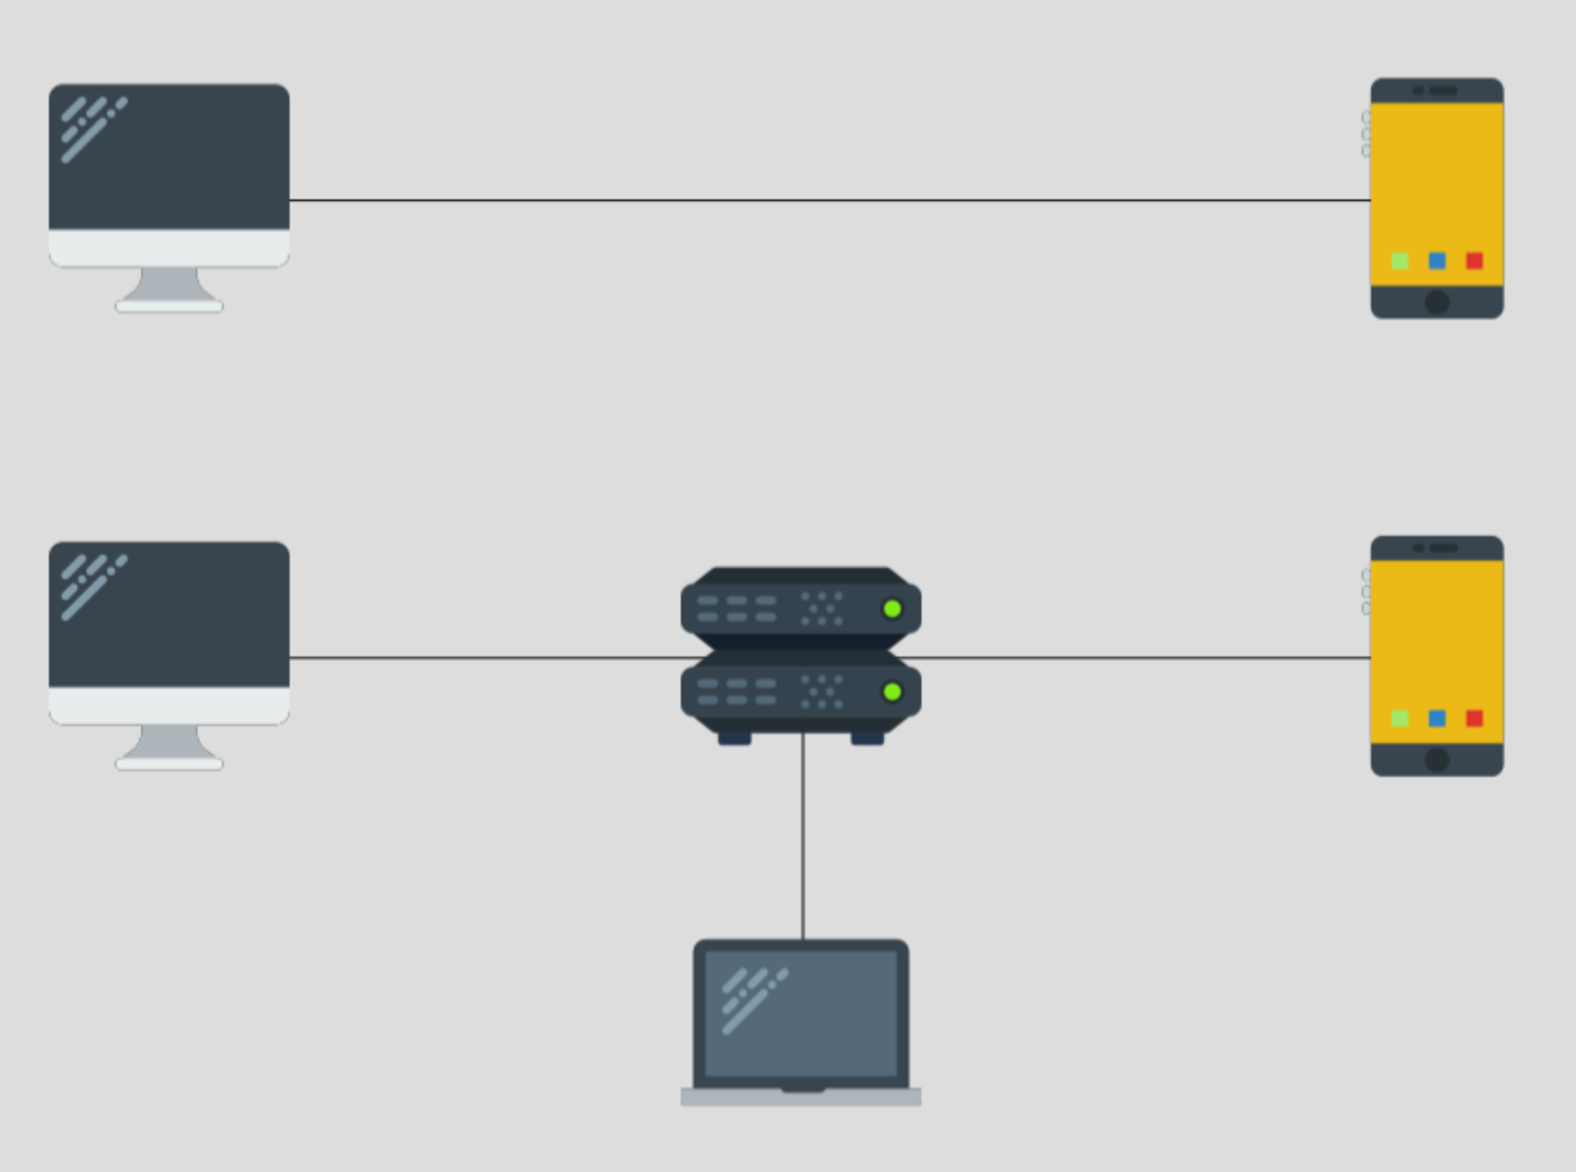
Man-in-the-middle (MITM) activity
Example Alice
Example Bob
Alice
Router
Bob
Eve
Notes:
So let’s move on to the ‘man-in-the-middle attack’ activity. This activity includes three parties: Alice, Bob, Eve.
The top of the activity has an example animation with example Alice and example Bob. Alice and Bob want to communicate confidentially.
The bottom of the activity has a router and Eve is connected to the router. Eve is an attacker. Eve tries to eavesdrop on Alice and Bob’s communication. Eve wants to break confidentiality and obtain plaintext messages. You’re going to be inserting packets into the bottom of the activity.

Slide 44
Keyrequest
Example Alice
Example Bob
Packet info
srcip | Example Alice
dstip | Example Bob
proto | encryption
type | keyrequest
key | 123456
Example Alice says to Example Bob: Can we use the key 123456?
Notes:
Alice sends a keyrequest message to Bob.

Slide 45
Keyresponse
Example Alice
Example Bob
Packet info
srcip | Example Bob
dstip | Example Alice
proto | encryption
type | keyresponse
key | 123456
Example Bob says to Example Alice: Sure, let’s use the key 123456.
Note: Bob can also send a different key in a packet of the keyresponse type.
Notes:
Alice receives a keyresponse message from Bob.

Slide 46
Encrypted message
Example Alice
Example Bob
Packet info
srcip | Example Alice
dstip | Example Bob
proto | encryption
type | message
key | 123456
Example Alice encrypts the plaintext message “message” to Example Bob, using the key 123456.

Slide 47
Keyrequest: bottom animation
Example Alice
Example Bob
Packet info
srcip | Alice
dstip | Bob
proto | encryption
type | keyrequest
key | 123456
Alice says to Bob: “Can we use the key 123456?”
Eve steals Alice’s packet (previous activity!). Bob doesn’t get Alice’s packet!
Notes:
Eve has control over a router between Alice and Bob. She can see all messages that pass through this router and she can spoof messages from either Alice or Bob.

Slide 48
Bottom animation: Goals
You are Eve. You want to have two separate conversations with Alice and Bob, while misleading them into thinking they’re talking to each other.
You’ve stolen Alice’s keyrequest packet. Respond back to Alice’s keyrequest packet. Trick Alice into encrypting her message with Eve's key: 31337.
Trick Bob into thinking he got the encrypted message from Alice, with Alice's key: 123456.
Notes:
In this activity, you are the attacker or eavesdropper Eve. You should have two separate conversations with Alice, Bob, deluding each into believing that they are talking with the other.
You’ve stolen Alice’s keyrequest packet. You have two goals, so you’ll be sending two packets. First, as Eve, respond back to this packet with a keyresponse. Trick Alice into encrypting her message with Eve’s key 31337.
Second, you need to trick Bob into thinking he got an encrypted message from Alice, with Alice’s key.

Slide 49
Bottom animation: Goals
You are Eve. You want to have two separate conversations with Alice and Bob, while misleading them into thinking they’re talking to each other.
You’ve stolen Alice’s keyrequest packet. Respond back to Alice’s keyrequest packet. Trick Alice into encrypting her message with Eve's key: 31337.
Eve can send a spoofed packet of type: keyresponse, setting Bob as the srcIP, key:31337 and other fields (proto:encryption).
Trick Bob into thinking he got the encrypted message from Alice, with Alice's key: 123456.
Eve can send a spoofed packet of type:message, setting Alice as the srcIP, key: 123456 and other fields (proto:encryption).
Notes:
So for the first goal, Eve can use her spoofing skills to pretend to be Bob. Eve will send a spoofed packet of type: keyresponse, setting Bob as the srcIP and the key 31337. So let’s try to do that. Keep in mind we’ll also need to set the proto field of the packet, as in the simulation.
Now moving on to the second goal, Eve wants to trick Bob into thinking he got an encrypted message from Alice.
Again, Eve can spoof a packet to Bob, pretending to be Alice. This packet will contain a ciphertext message and so its type will be ‘message’.
Eve can set Alice as the srcIP, key: 123456 and other fields (proto:encryption).
So that concludes the man in the middle attack.

Slide 50
Learning outcomes
Demonstrate that a basic encryption protocol that simply sends a shared secret is insecure as it is vulnerable to a man-in-the-middle attack.
Describe a man-in-the-middle attack: two users (Alice, Bob) are convinced that they are talking to each other using a secret key, whereas in reality, an attacker (Eve) also knows the secret key and can read or modify the users’ messages.
Recognize a man-in-the-middle attack as an example of an interception threat.
Takeaways: In real-life, both parties use key exchange schemes to compute a shared secret key. Even if Eve tries to intercept their communication, she will not be able to compute this secret key.
Visual resource on Encryption and Public Key Cryptography: https://idea-instructions.com/public-key/

Slide 51
Using and extending Netsim

Slide 52
Integrating Netsim
Many ways to integrate Netsim into your teaching, depending on your lesson plans, mode of teaching (online / in-person).
Have enough time for students to play Netsim in class? → Do it! Interleave game levels with microlectures.
Cannot include Netsim in class? Have an online component? → Students can play Netsim at home, replacing or complementing instructional material on network security.
Can extend Netsim to teach other protocols and networking commands, before going to CTFs.
Notes:
Including Netsim game levels as in-class activities, interleaved with microlectures.
However, if you don’t have time for students to play Netsim in class, you can have students play it online, at home, since it is quite directed. So you can use Netsim to replace or complement instructional material on network security. I’ve had experience in online teaching due to the pandemic and I’m particularly interested in flipped classrooms. So, in a flipped classroom, you might have students go through each …

Slide 53
Including Netsim in class
[Previous class / intro] Teach pre-requisites such as protocols, packets and network layers before.
Students can go through a set of game levels. Answer questions; encourage students to experiment sending different packets.
Bring students back to walk through challenging levels.
Example: Switch table & timing of our trigger packets in stealing activity.
Wrap-up with takeaways and learning outcomes.

Slide 54
Netsim in online teaching
Can go through a similar structure as in-class rooms, using breakout rooms to allow students to go through the game in class.
Can use slides to walk through activities and discuss takeaways.
Timing: Be mindful of time spent on technical difficulties, including transitioning to/out of breakout rooms.
For asynchronous teaching & flipped classrooms: Need to include any per-activity background and takeaways within the game levels.

Slide 55
Flipped classrooms
In-class activities
Walk through games in later levels (e.g. Stealing Packets or MiTM), discussing concepts (switch tables / timing / Caesar ciphers) & emphasizing takeaways.
Pre-class content
Go through Netsim ‘Basics’ game levels by themselves.
Can include some basics of protocols, packets, network layers to complement the ‘Getting Started’ game.
Post-class (assessment)
Complete levels that do not require close intervention (e.g. DoS).
Quiz students on caveats for each game.
Notes:
In flipped classrooms, we want students to prepare some content before the class, this could mean reading material, videos, and so on — students should be able to go through the content by themselves. For flipped classrooms to work, students need to have gone through this content before class, so we want to motivate students to complete this content perhaps through some formative assessment on the pre-class content. In class, we want to engage students through activities; we want deep learning to happen in class. So we want to discuss common difficulties and provide feedback. Post-class, the advice is to extend in-class activities with other asynchronous activities or assessments that segue into the pre-class content for the next class.
If you’re planning to do a flipped classrom, the cool thing about interactive games such as Netsim is that you can apply it to either of these three stages.
Students would be motivated and excited to play a game such as Netsim, so you can have students go through Netsim basics game levels by themselves. Keep in mind that you should include some basics of protocols, packets and network layers to complement the ‘getting started’ game. Overall, for the pre-class stage, ensure that you’re not adding more content for students: preferably replace other content. So communicate the total amount of time students should spend on the game levels and any prep material.
In class, you can then walk through games in later levels that build on the earlier ones and have multiple learning outcomes, such as the stealing packets or man-in-the-middle activities. You can have small Q&A or think-pair-share activities to discuss foundational concepts for these activities in class, such as switch tables or Caeser ciphers and emphasize takeaways or learning outcomes after discussing each game.
Finally, students can go through any levels that do not require close intervention, such as the DoS activities, by themselves after the class. You can easily design a quiz on the takeaways and caveats for each game.
Important thing is, you can split games into three parts: one part that they can go through before class, another difficult part that they’ll do in class, with walkthroughs and a final part that they can do after class, followed by a formative assessment such as a quiz.

Slide 56
Adapting Netsim for online / flipped classrooms
Tweak text panels on RHS to include or point to any resources.
[Getting started.] Slides on packets, network protocols.
[Man-in-the-middle attack.] Slides introducing encryption, go through an example of Caeser ciphers.
Tweak success message to include takeaways and learning outcomes.
[Stealing Packets.] Learning outcomes: This activity shows that IP spoofing can be used to steal packets that are intended to be sent to someone else. It also shows the role of timing in attacking systems.
[Man-in-the-middle attack.] Takeaways: In real-life, instead of simply sending a secret key, both Alice and Bob securely compute a shared secret key, after sharing some numbers publicly and keeping other numbers private.
Notes:
Now for the pre-class or post-class stages, you can tweak the text panels on the RHS to include or point to any resources. Currently, you see a default success message, so you can tweak that to include takeaways and learning outcomes for each game.

Slide 57
Extending Netsim
Improve abstractions.
Can be used to teach other protocols (e.g. DNS) and demonstrate attacks against them (e.g. DNS poisoning)
Other types of attacks (e.g. side channels)
Motivate defenses (e.g. IP spoofing and IPSec)
Motivate networking commands (e.g. traceroute activity).
Play Netsim before preparing for CTFs.
Notes:
More generally, you can extend Netsim in many ways. We can start with improving abstractions, for example, Netsim currently uses names as network identifiers instead of IP addresses. You can use Netsim to teach other protocols such as DNS and demonstrate attacks against them, such as DNS poisoning. You can also demonstrate other types of attacks, such as side channel attacks. You can motivate defenses through the games — for example IP spoofing activity can be used to motivate IPSec. You can also design games to motivate networking commands, such as in the traceroute activity. For those of us preparing students for CTFs, Netsim can provide an abstract environment to learn basics of network security attacks, before doing sample CTF questions on network security.

Slide 58
Activity: Netsim for your class
Design a lesson plan to integrate Netsim in your class.
This could be an in-person or online class or a flipped class.
Consult the lesson plan example. Feel free to pair up.
An alternative for the brave:
Consider how you can extend Netsim for your class.
The lesson plan example includes the list of points we just saw.

Slide 59
Netsim technical overview
Written in PHP, JavaScript, HTML, CSS.
Game level = Devices, links, timeline of packets sent
“Success” = Packet triggers
Github Repo: https://github.com/dettanym/netsim/tree/master
See note on Extending Netsim in Readme
Notes:
A few notes on the technical implementation of Netsim: it’s written using PHP, Javascript with HTML and CSS. Each game level is specified in terms of devices, links, and a simulation timeline of packets exchanged. Conditions for success are also specified in terms of packet ‘triggers’. A Github repo is available, so you can fork it, and consult the note on extending Netsim, and craft other protocols and attacks.

Slide 60
Takeaways
Netsim is an online network simulator game, to teach basics of computer networks and demonstrate network security attacks.
Detailed walkthroughs of a couple of games.
A lesson plan on integrating Netsim for your class.
Discussed ways to extend Netsim.
Broader lesson: Integrating security within a design can help you later
Access talk + materials later: https://dettanym.github.io
Miti Mazmudar
Notes:
and extend it as basic instructional material for CTFs.
Integrate Netsim for in-person teaching, online teaching and flipped classrooms.
Extend Netsim to teach other protocols, attacks, defenses.

Slide 61
Real-world defenses & resources
Encryption and Public Key Cryptography
Visual resource: https://idea-instructions.com/public-key/
Protecting against man-in-the-middle attacks: HTTPS
Activating HTTPS features of sites that you visit: HTTPS Everywhere - https://www.eff.org/https-everywhere/faq
Support HTTPS on your website: Certbot - https://certbot.eff.org/
Assessing your digital security and privacy:
Consumer Reports Security Planner: https://securityplanner.consumerreports.org/

